Slide 1
PROJECT 1:
Credit Mortgage Portfolio analysis and determining the relationship between unemployment and no-payment
#Team of 5
Members:
Rubi Trujillo
Ricardo Rechi
Carlos Granados
Gonzalo Cienfuegos
Justin Evert

Slide 2
HYPOTHESIS
HYPOTHESIS: IF there is a relationship between mortgage repayment rates and state unemployment rates, THEN states with higher unemployment rates should also have higher rates of mortgage payment delinquency (morosidad)
NULL HYPOTHESIS: IF there is no relationship between mortgage repayment rates and state unemployment rates, THEN state unemployment rates should have no effect on mortgage repayment delinquency (morosidad) rates
SCOPE = MEXICO

Slide 3

FINDING & COLLECTING THE DATA
Genworth
Data provided directly to team by Genworth with express permission to use for project purposes
2 x Excel files each with between 18,000 - 20,000 entries which included data used to calculate the feasibility and/or risk of mortgage reinsurance policies (“reservas”) for January 2019 & February 2019
File: Clean_Table.ipynb

Slide 4
MOTIVATIONS FOR THE STUDY
MOTIVATIONS
PRACTICAL MOTIVATIONS:
It’s important for the firm to monitor the performance of the portfolio month by month to determine the level of no payment, also to determine in an efficient way that the client's information we receive has no errors.
In real life the process of validation is done through excel, also the portfolio analysis cannot be done efficiently because a large range of information cannot be handled by the same tool.

Slide 5
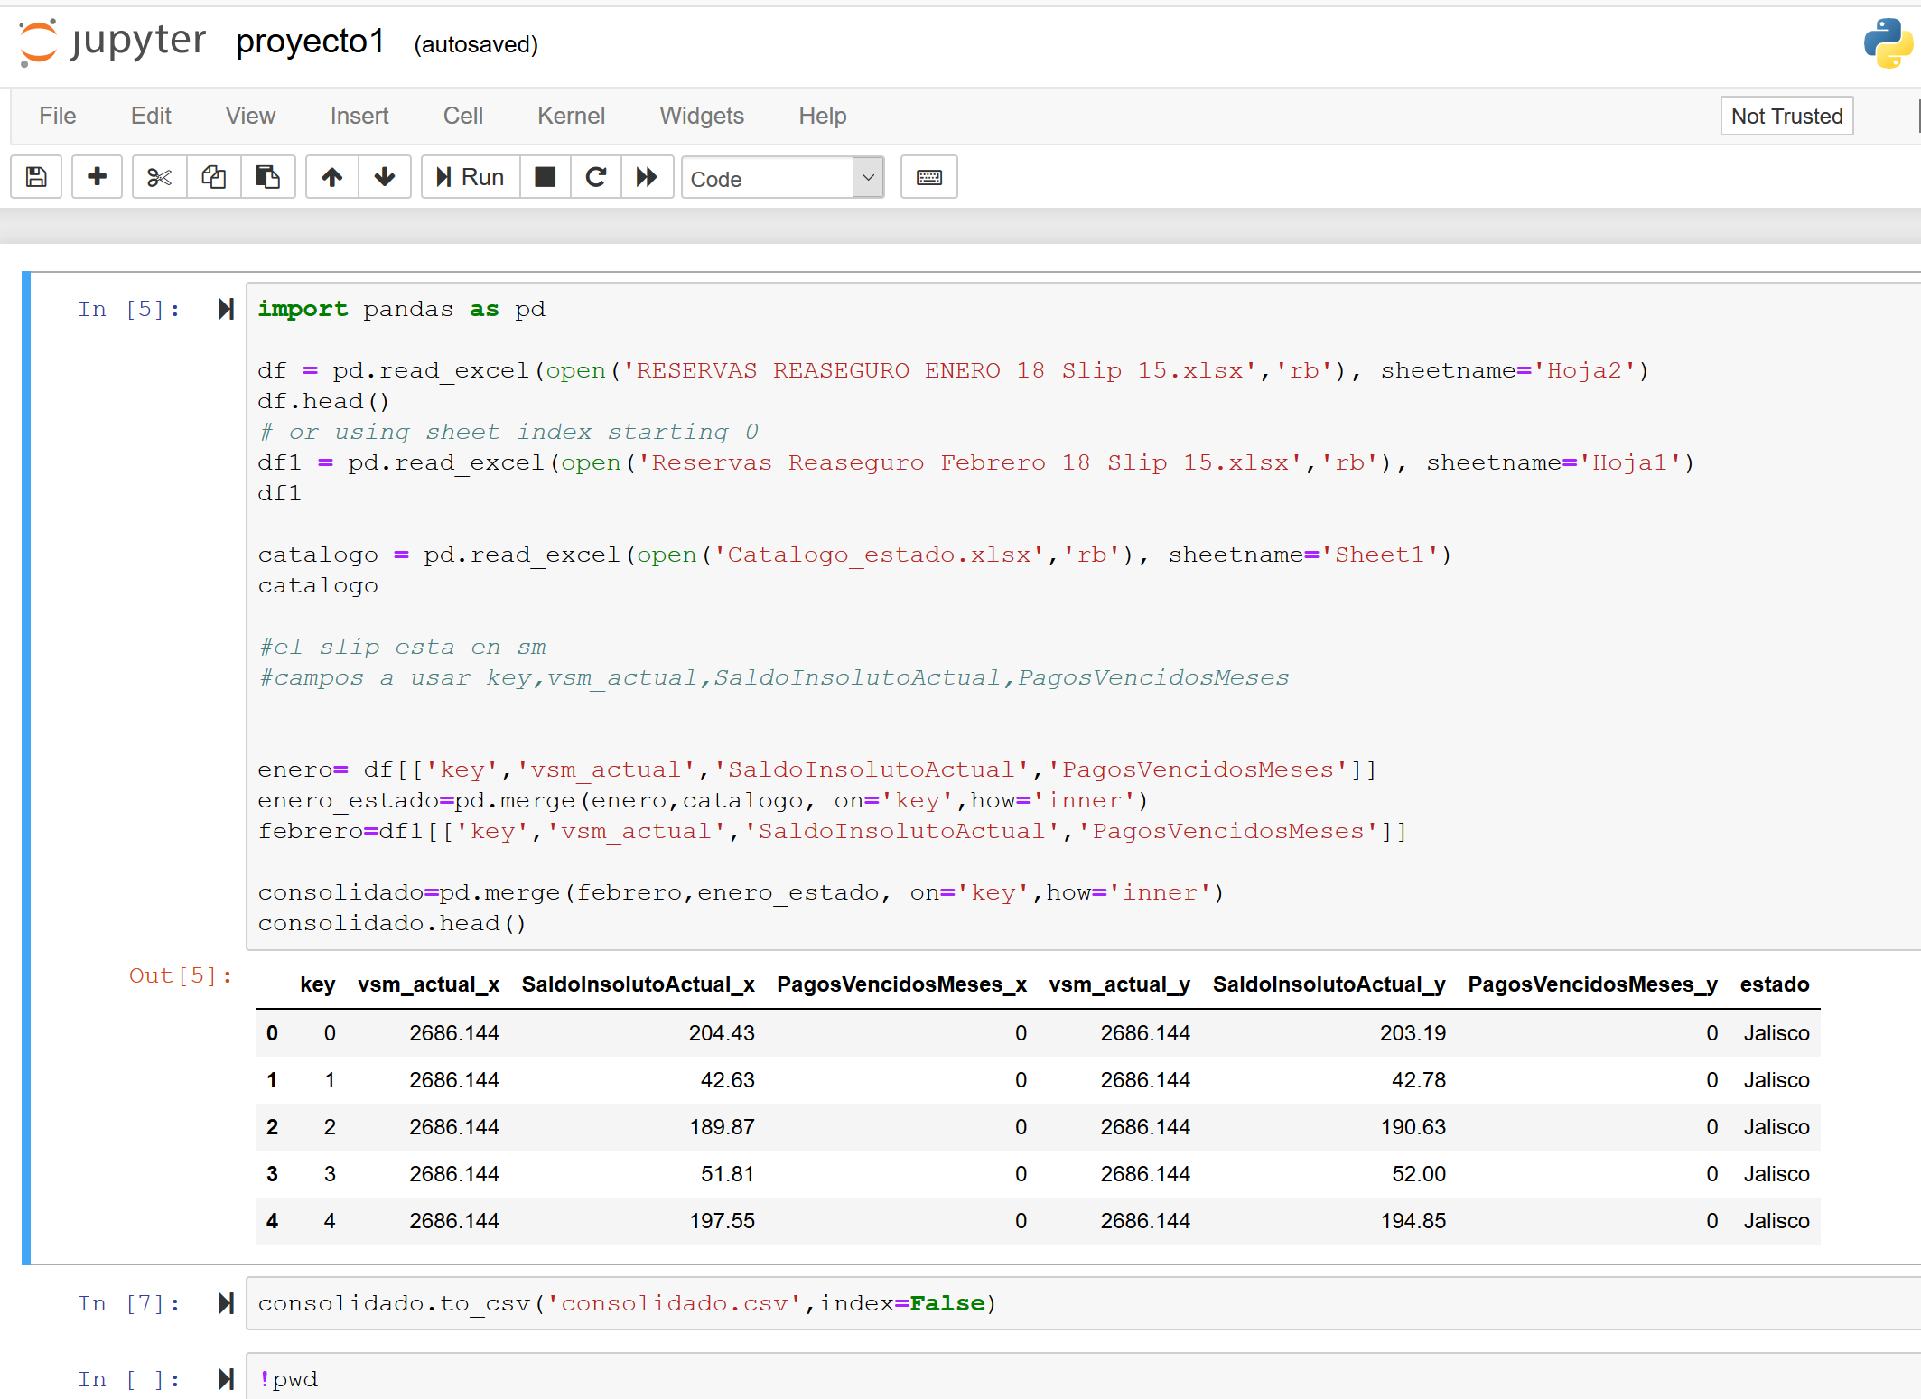
GW DATASET CLEANUP & ANALYSIS PROCESS
STEP 1: GENWORTH DATA
Use Jupyter Notebook and Pandas to:
Read and merge both Genworth Excel files (January & February) into one consolidated file
Convert and save as a csv file
Create Data Frames to isolate and display target data from the consolidated csv
File: Clean_Table.ipynb

Slide 6
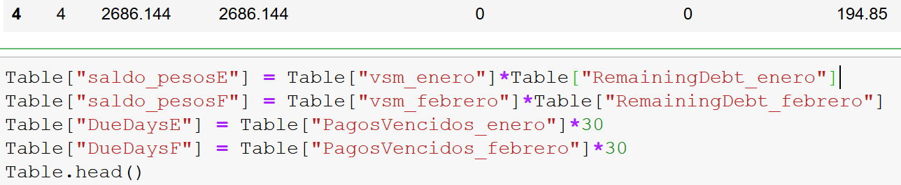
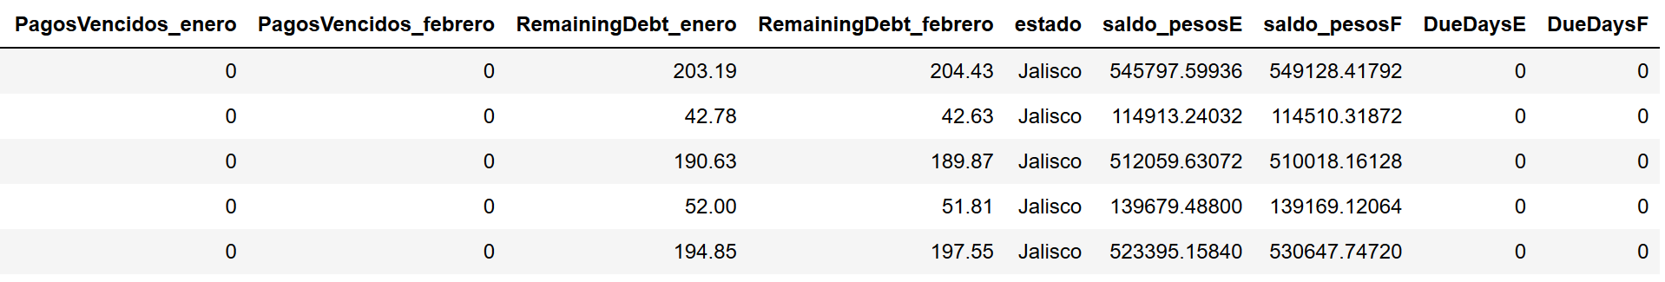
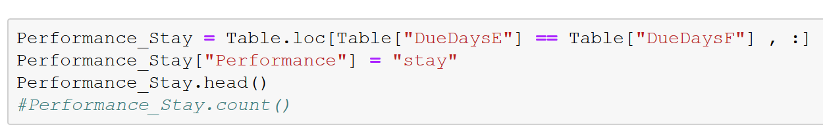
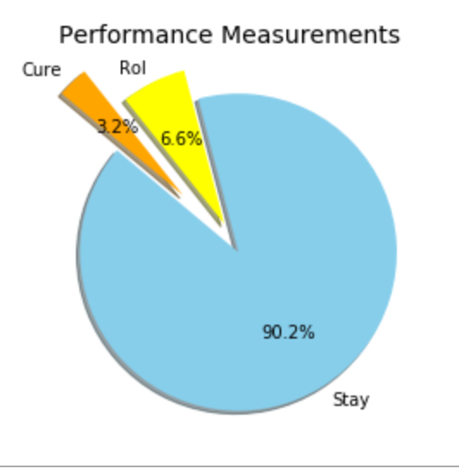
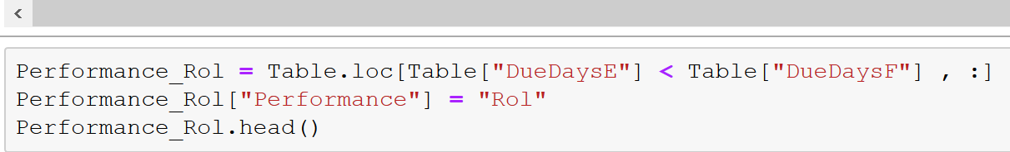
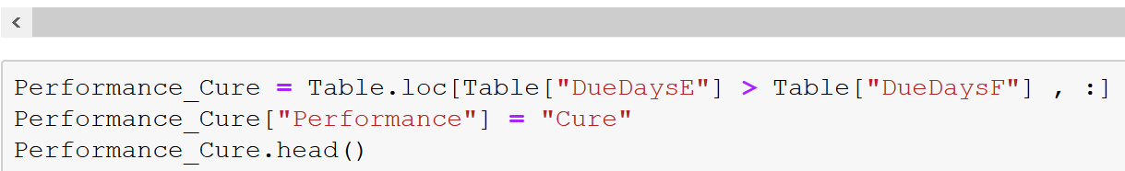
THE DATA CLEANUP, EXPLORATION & ANALYSIS PROCESS
STEP 1: GENWORTH DATA
Use Jupyter Notebook, Pandas, MatPlotLib and created DataFrames to:
Clean target data (error removal)
Begin manipulation and exploration of target data (calculations, new data columns, etc)
Begin using basic graphics to visualize manipulated data as a means to facilitate initial exploration of trends as they relate to the hypothesis
File: Clean_Table.ipynb

Slide 7
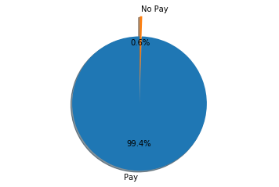
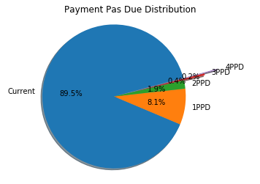
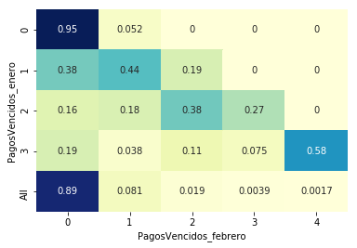
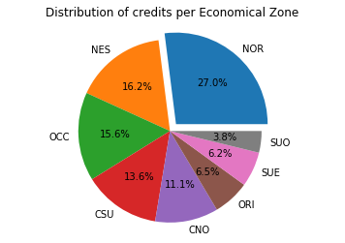
EXPLORATION & ANALYSIS PROCESS
STEP 1: GENWORTH DATA: Use Jupyter Notebook, Pandas, MatPlotLib and created DataFrames to:
Portfolio analysis to determine quality of credits and delinquency rates & learning about profile
Transition Matrix of payments
No Pay=0.56%
File: Final-Code_Project_1-18July.checkpint.ipynb

Slide 8
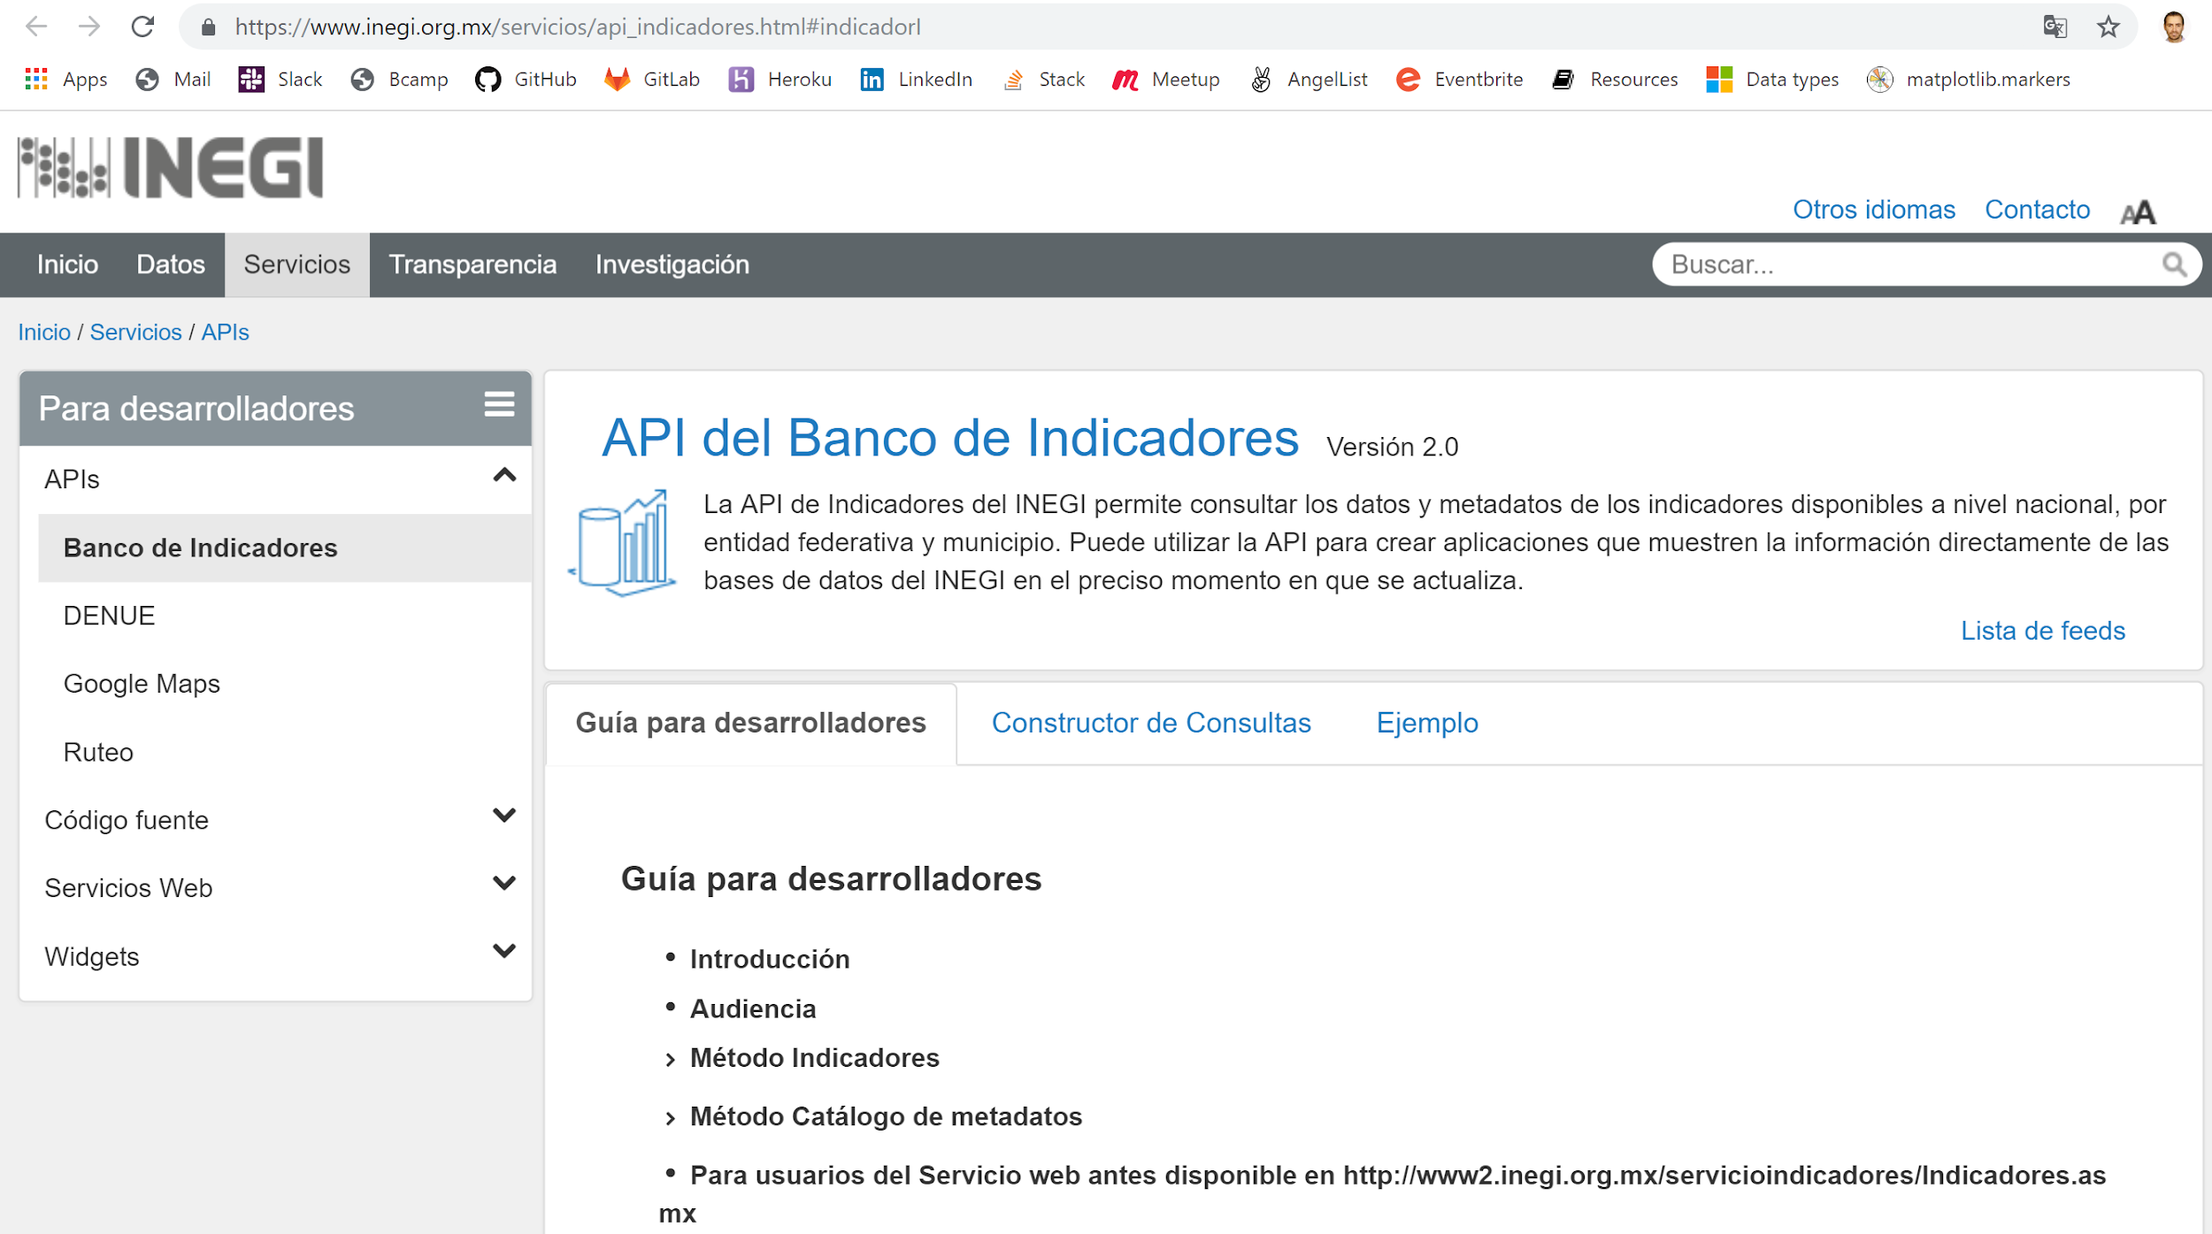
FINDING & COLLECTING DATA TO CORRELATE WITH
INEGI API
Process
Documentation - unfriendly
Search for State Unemployment Rates
Getting familiar to “decipher” API
File: INEGI_API_National-Copy1-checkpoint

Slide 9
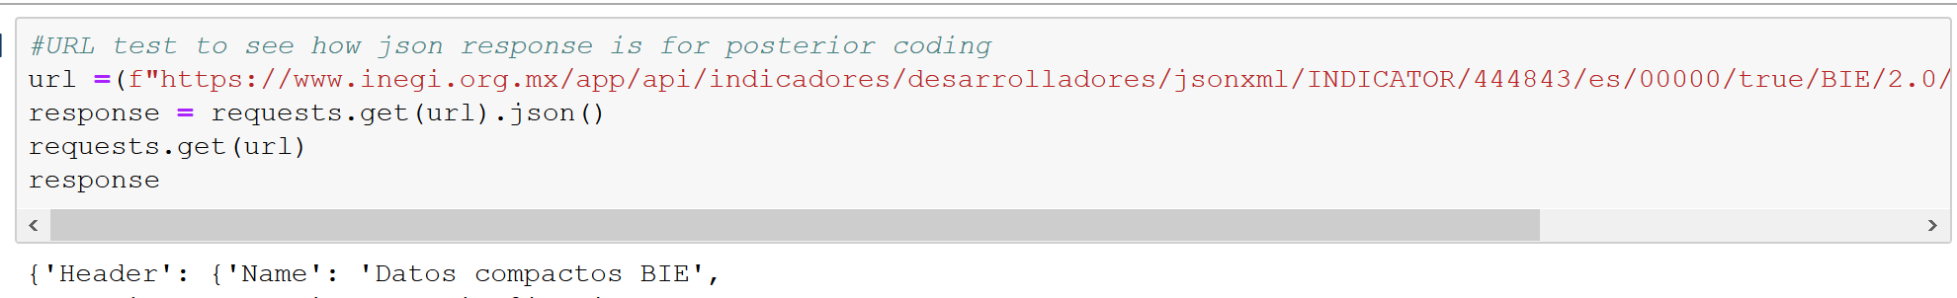
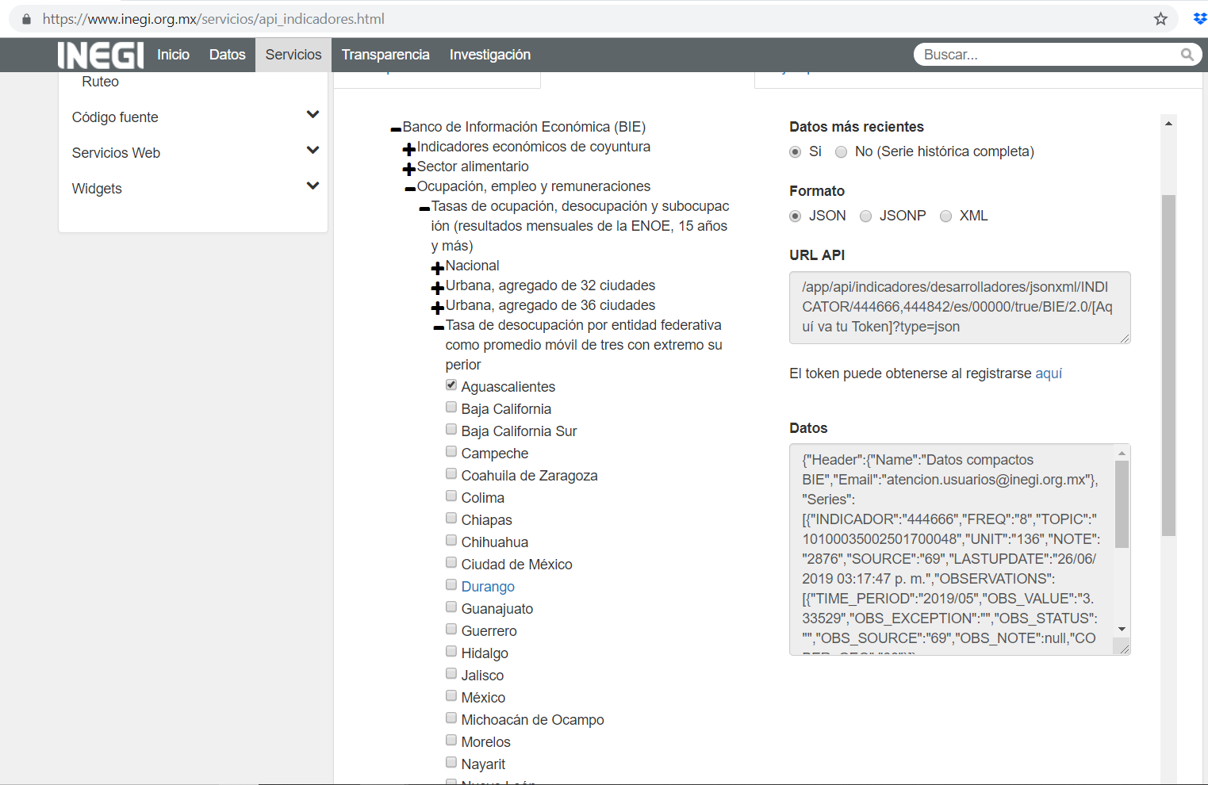
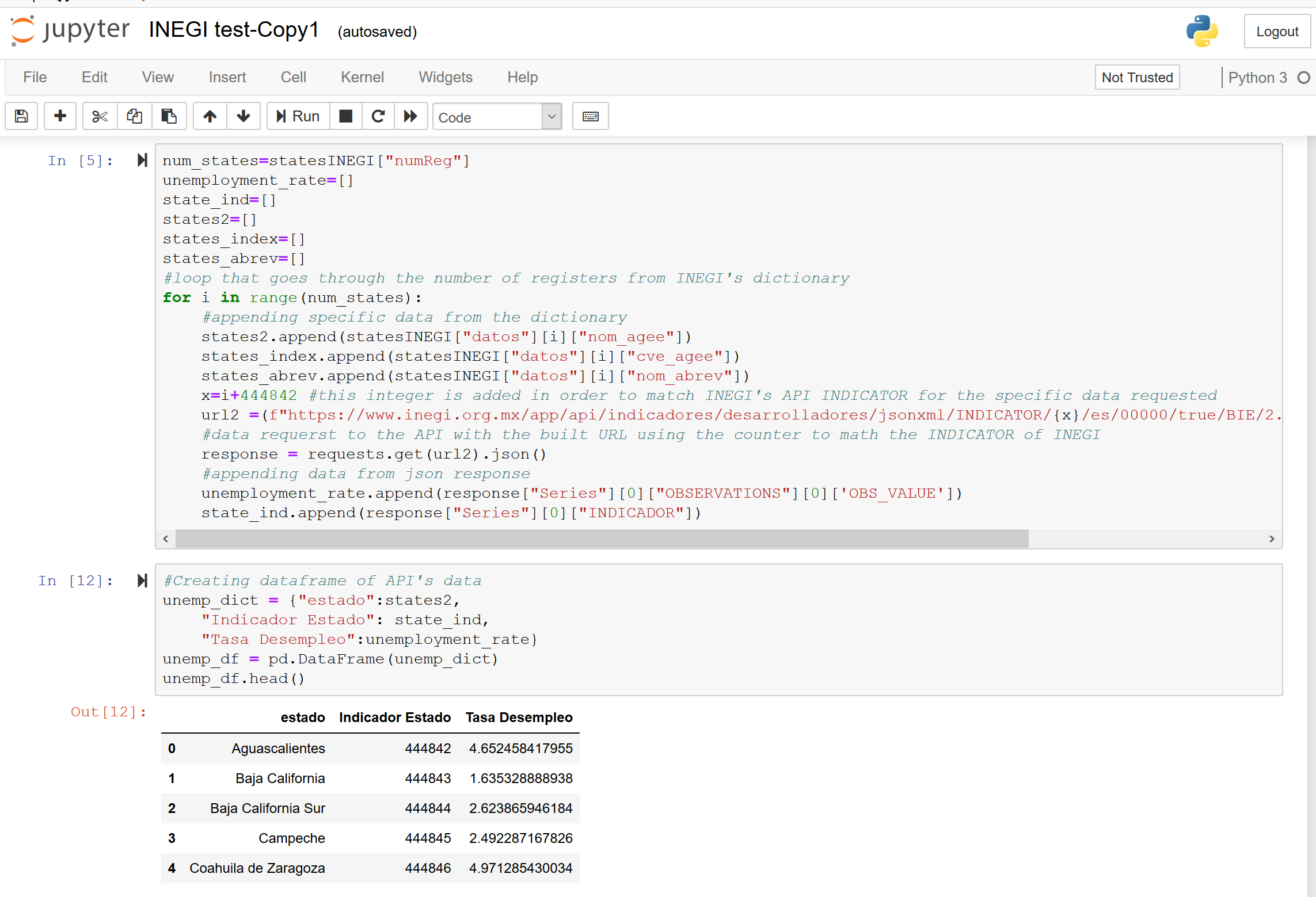
THE DATA CLEANUP, EXPLORATION & ANALYSIS PROCESS
STEP 2: INEGI API URL & Data processing
Studying URL constructor - KEY
Indicator branches/~”index”
Use Pandas & JSON for-loop to:
Retrieve INEGI data
for-loop; append, dF, and
slicing data for cleaning and processing
Save output as a csv file
File: INEGI_API_National-Copy1-checkpoint

Slide 10
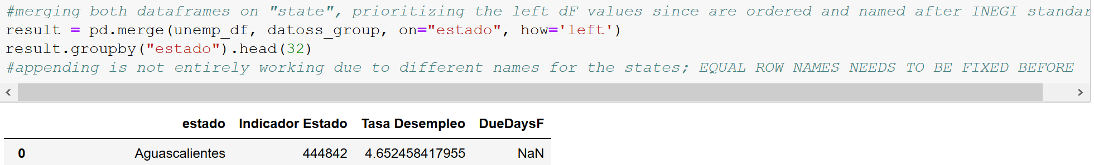
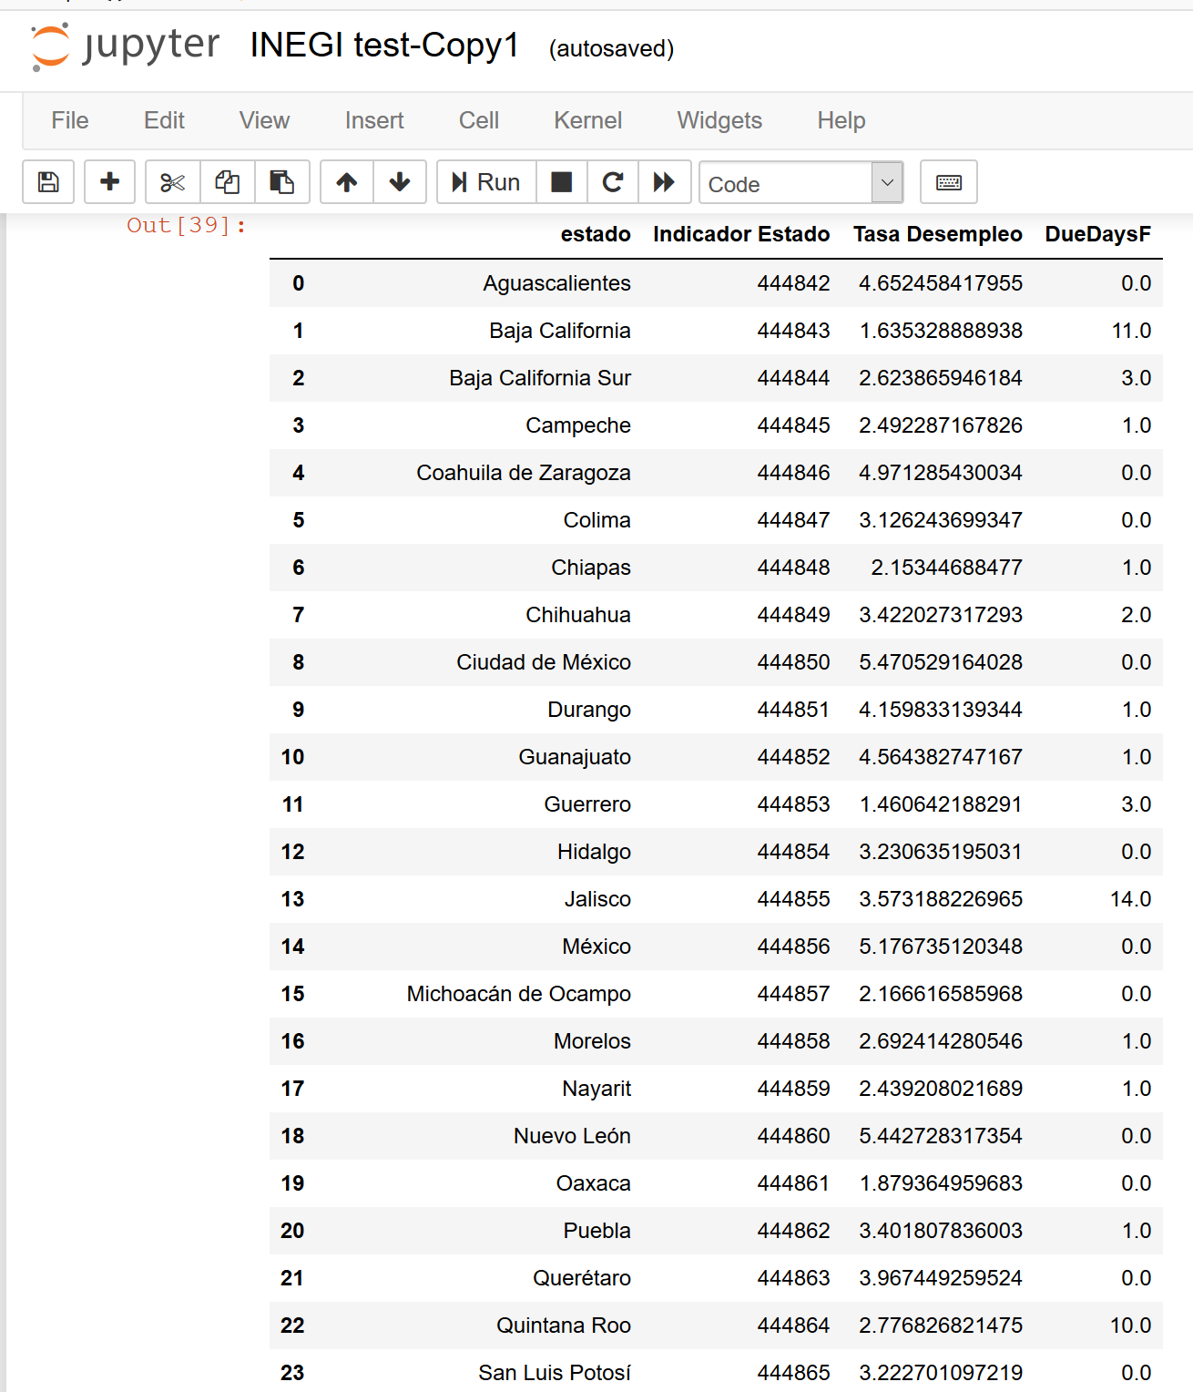
THE DATA CLEANUP, EXPLORATION & ANALYSIS PROCESS
STEP 3: MERGE GENWORTH & INEGI DATA (FIRST ROUND)
Use Jupyter Notebook & Pandas to:
Merge the first and second data sets
Isolate target mortgage and unemployment rate data in DataFrames to facilitate analysis
File: INEGI_API_National-Copy1-checkpoint

Slide 11
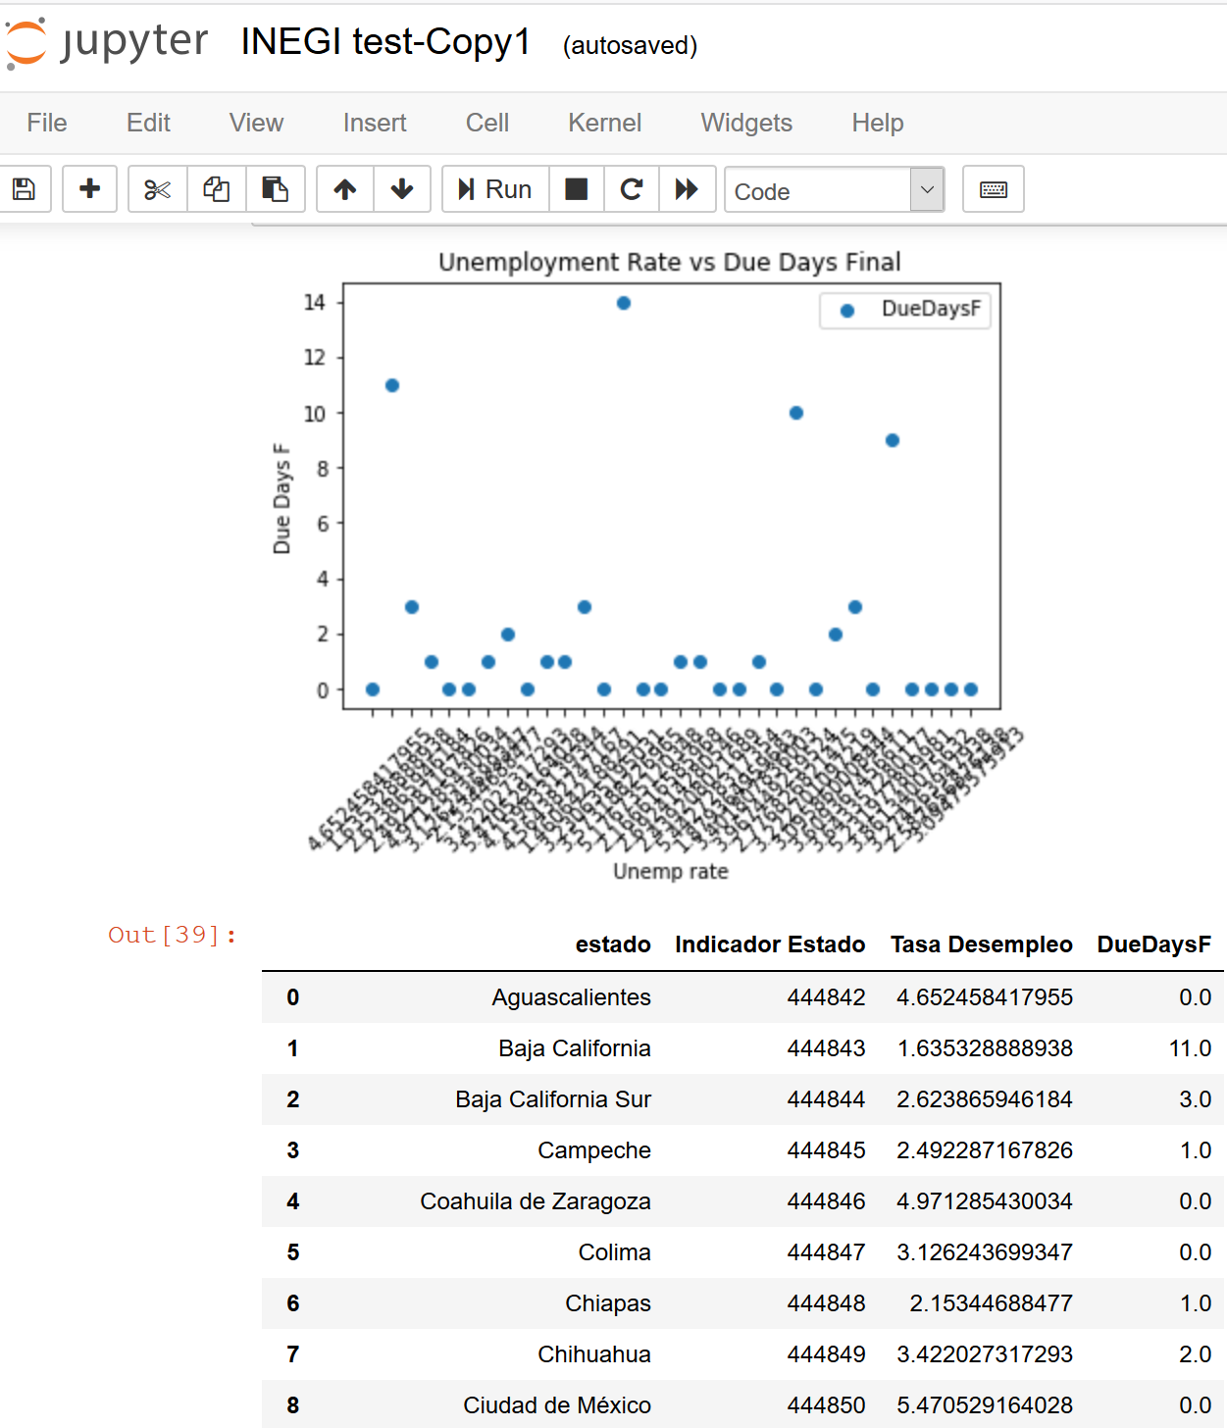
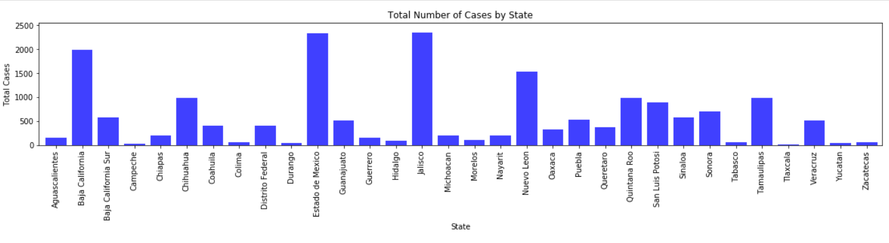
THE DATA CLEANUP, EXPLORATION & ANALYSIS PROCESS
STEP 4: ANALYSIS, GRAPHIC FIRST IMPRESSIONS
Pandas & MatPlotLib to conclude:
NULL can’t go!, but why??...
The first data set is limited (too young) in terms of the number of mortgage cases AND the number of mortgage defaults per state is not representative vs public data chosen
The first data set is limited in terms of the time period of the sample freq (1 month)
Period mismatch?
File: INEGI_API_National-Copy1-checkpoint

Slide 12
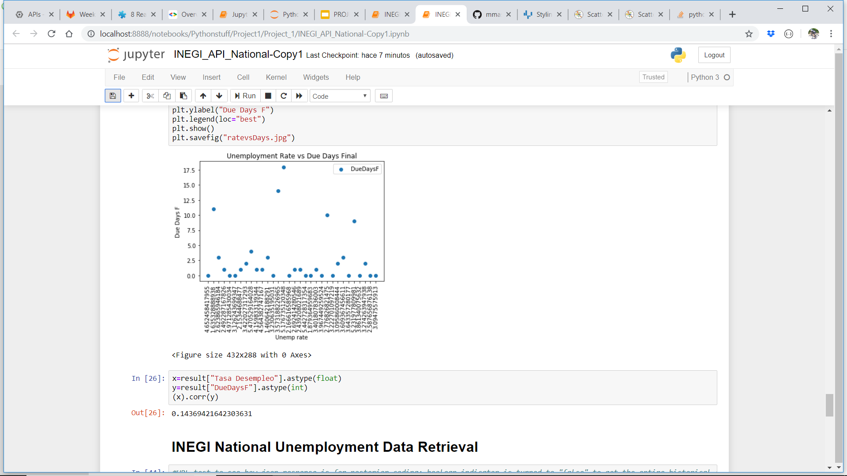
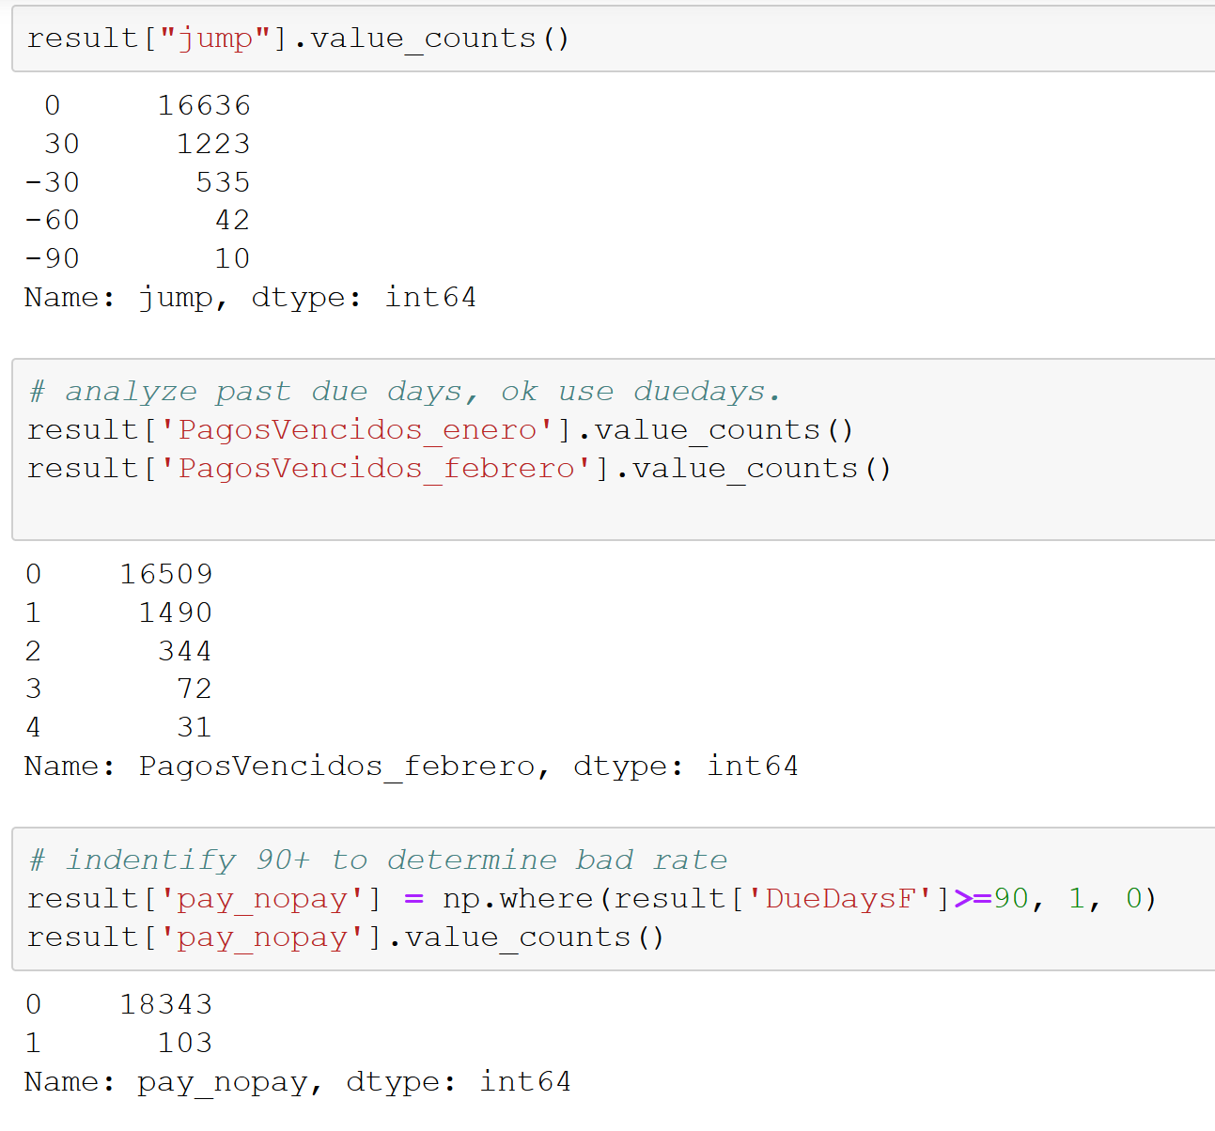
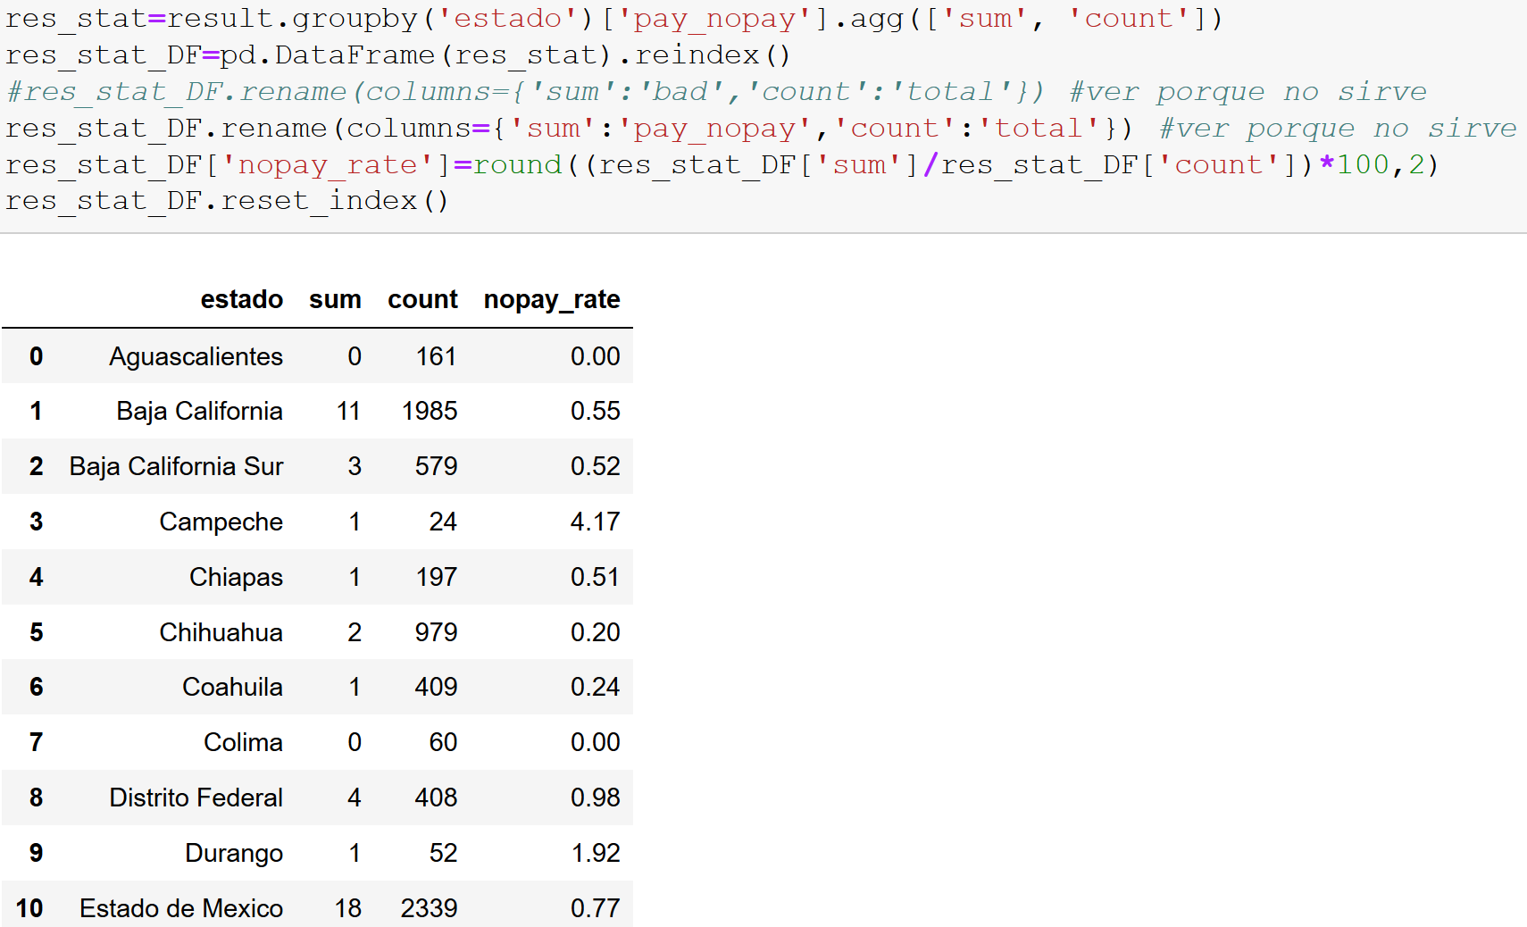
FIRST RESULTS
Downside:
Data doesn’t come from a random sample and participation in states is limited. Segment composed by young credits, so just very early for delinquency to occur.
Upside:
Jupyter Notebook & Pandas far more effective/efficient means to manipulate and process large data sets.
0.14 Correlation = not correlated
File: INEGI_API_National-Copy1-checkpoint

Slide 13
WHAT CAN WE DO NOW?
Since credits mortgages are not representative of whole portfolio, its performance can not been measured yet (good or bad credits) because they are recent compared with its term (at least >15 years), so we need to get more reliable data to have a benchmark of expected delinquency trends.
Also it would be useful to analyze external factors that could impact delinquency trends, such as economic factors: e.g. unemployment rate.
Where? We can get data from regulator (CNBV) and INEGI.
Why ? Analyze national & Bank1 delinquency rates, to determine if unemployment can affect payment quality of credits and if so, consider it as an additional factor for pricing the insurance premium in case these rates change.

Slide 14
CHANGE OF HYPOTHESIS: Analyze credit mortgages: Market All Banks & Bank1 correlation against national unemployment rate
HYPOTHESIS: Delinquency rates in mortgage credits segment are being impacted by unemployment rates (are correlated)
NULL HYPOTHESIS: Delinquency rates in mortgage credits segment are not impacted by unemployment rates (there is no correlation)
Two test will be performed:
Test1: Bank1 vs. national unemployment rates from last 36 months
Test 2: Market vs. national unemployment rates from last 36 months
Correlation will be analyzed and two hypothesis test will be done (T test & MannWhitney)

Slide 15
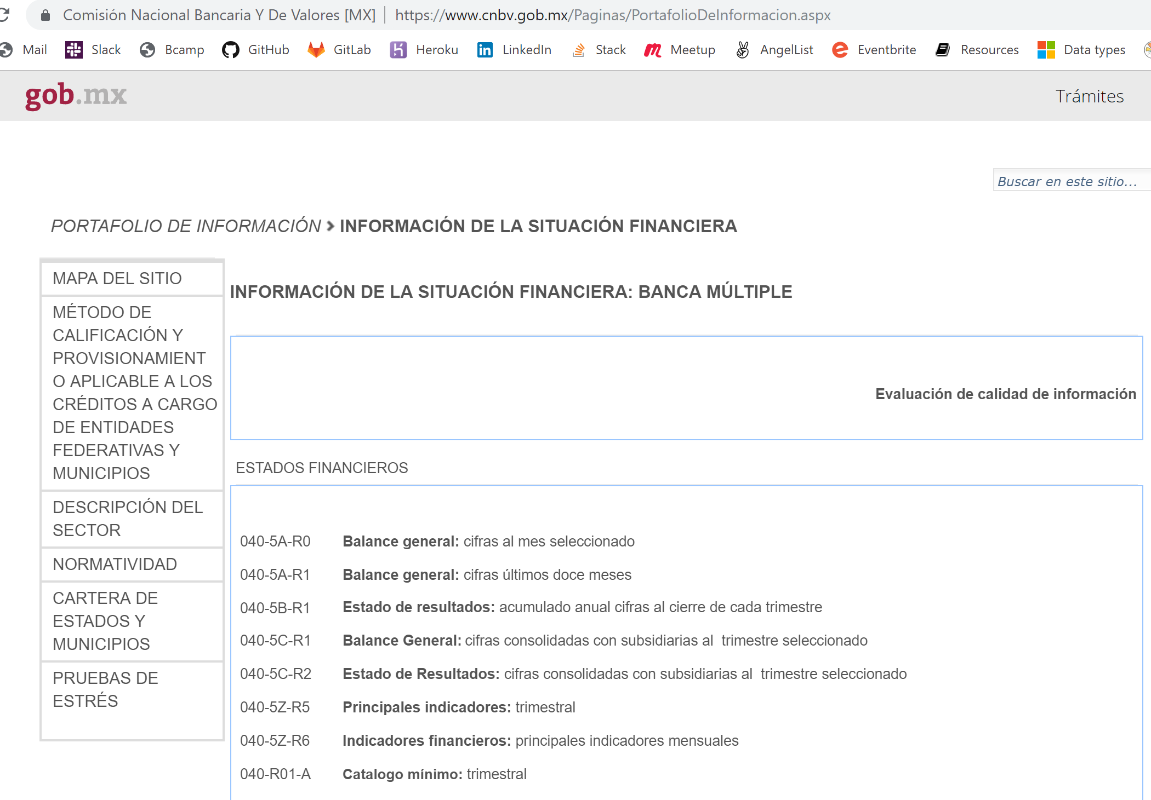
FINDING & COLLECTING THE DATA FOR THE NEW HYPOTHESIS
Comisión Nacional Bancaria y de Valores (CNBV)
Cartera de vivienda: número de créditos y saldo de cartera Julio 2019
Data focussed on mortgage default rates in the Mexican banking industry and the Bank we analyzed.
Data provided in CSV file format

Slide 16
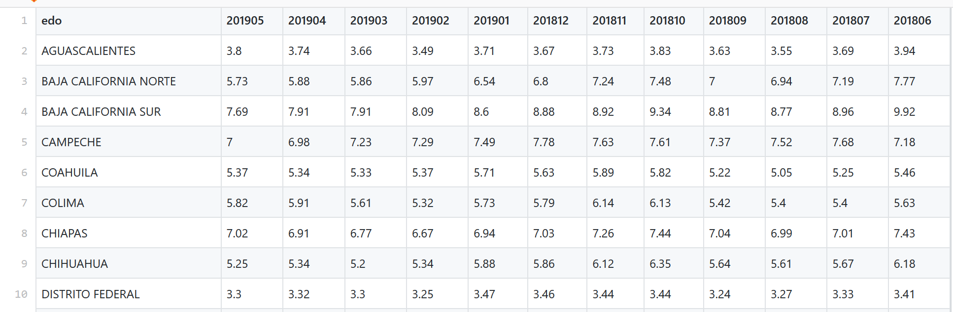
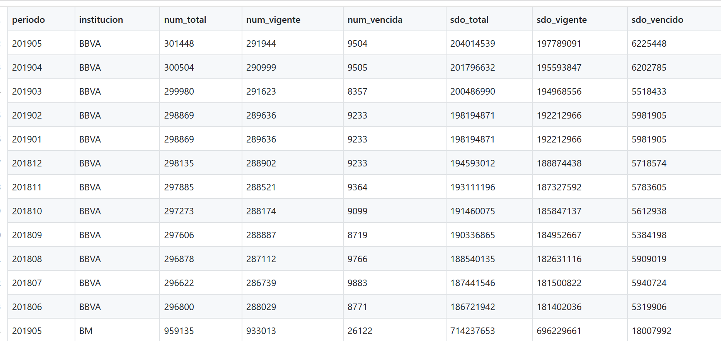
NEW DATA GATHERING
STEP 4: FIND NEW DATA WHICH ADDRESSES THE DATA LIMITATIONS OF FIRST ROUND DATA SET
Mature portfolio with credits with longer performance (originated years ago) to know expected delinquency rates.
NEW CNBV DATA addresses limitations of first round data via:
More extensive default numbers at national levels: global market & Bank1
Data covers a 36 month period: number of credits & balances.

Slide 17
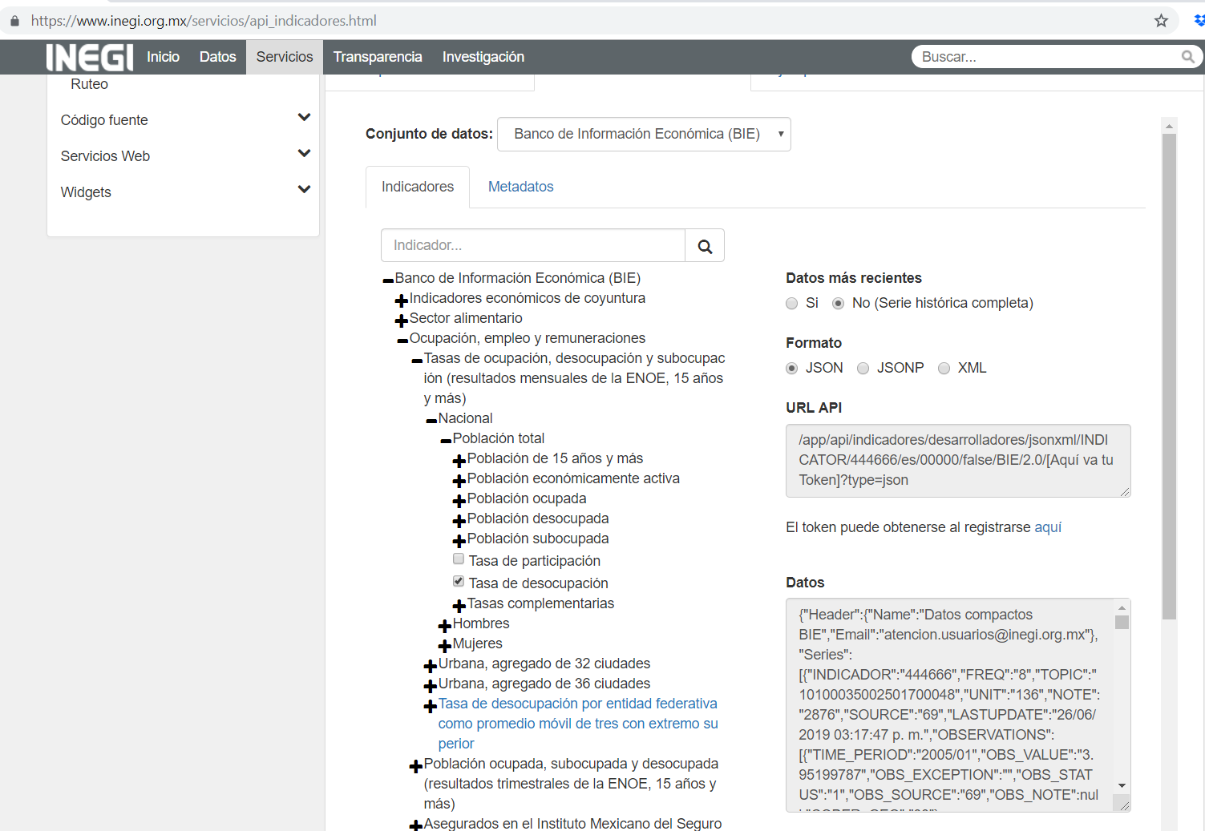
NEW DATA GATHERING
STEP 4: FIND NEW DATA WHICH ADDRESSES THE DATA LIMITATIONS OF FIRST DATA SET
NEW DATA FROM INEGI API:
National level unemployment rates for the 36 month period covered in the CSV data
Retrieving full historical series and processing to create new dF

Slide 18
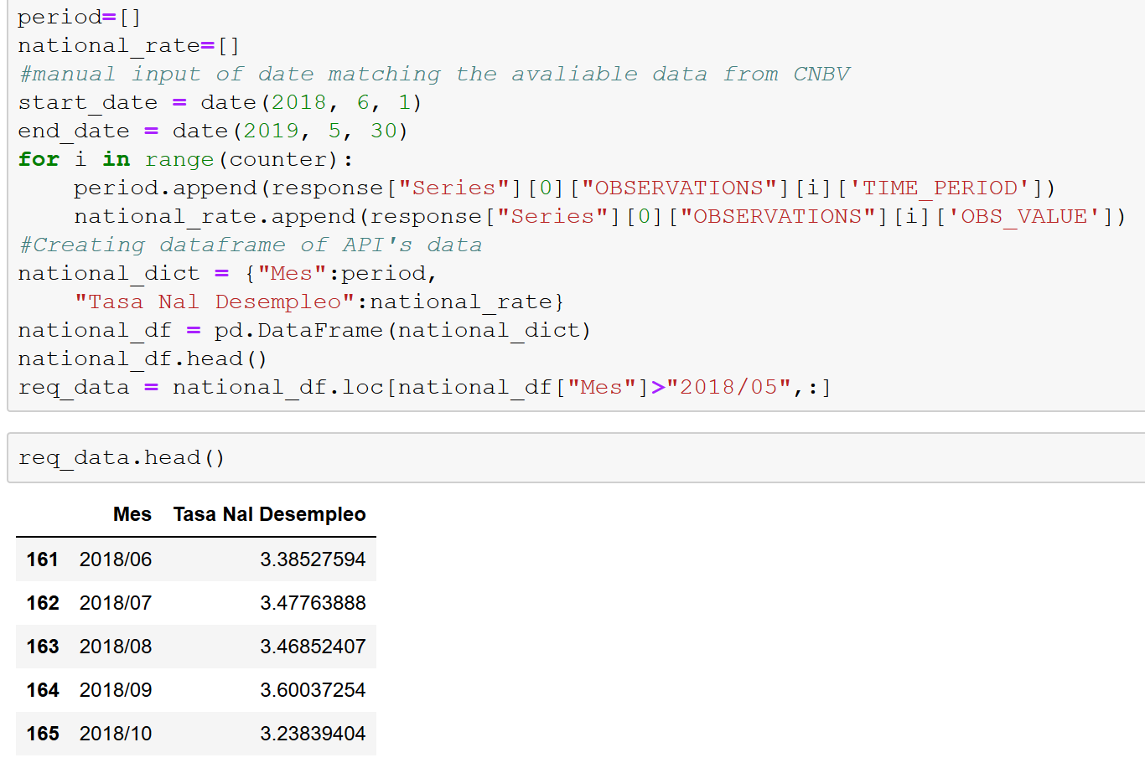
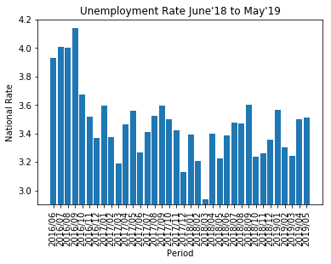
NEW DATA CLEANUP, EXPLORATION & ANALYSIS
STEP 4: FIND NEW DATA WHICH ADDRESSES THE DATA LIMITATIONS OF FIRST DATA SET
NEW DATA FROM INEGI API:
Notebook, Pandas, JSON & MatPlotLib to:
Repeat the same processes as applied to the first round data but now targeting national level unemployment rate data
Reject Null
3rd round: extend data from 12 months to 36 (final results)

Slide 19
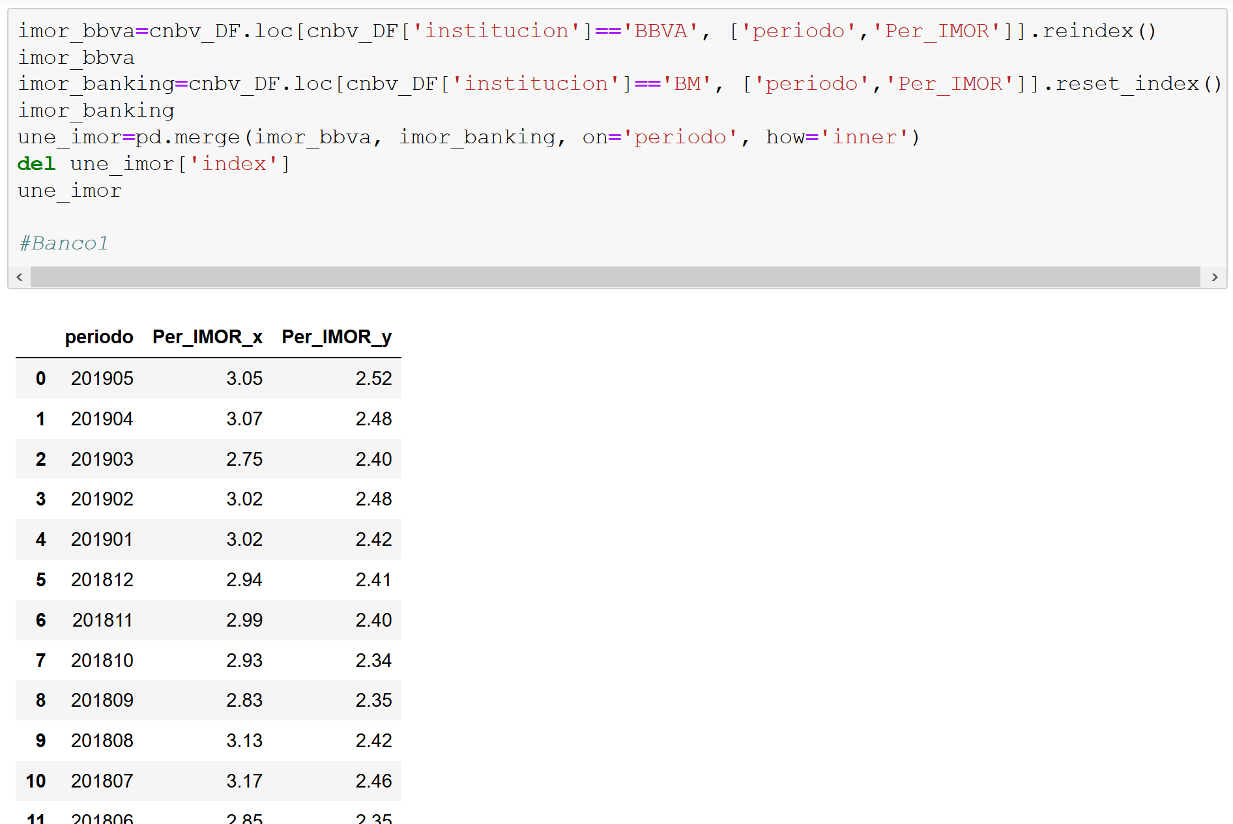
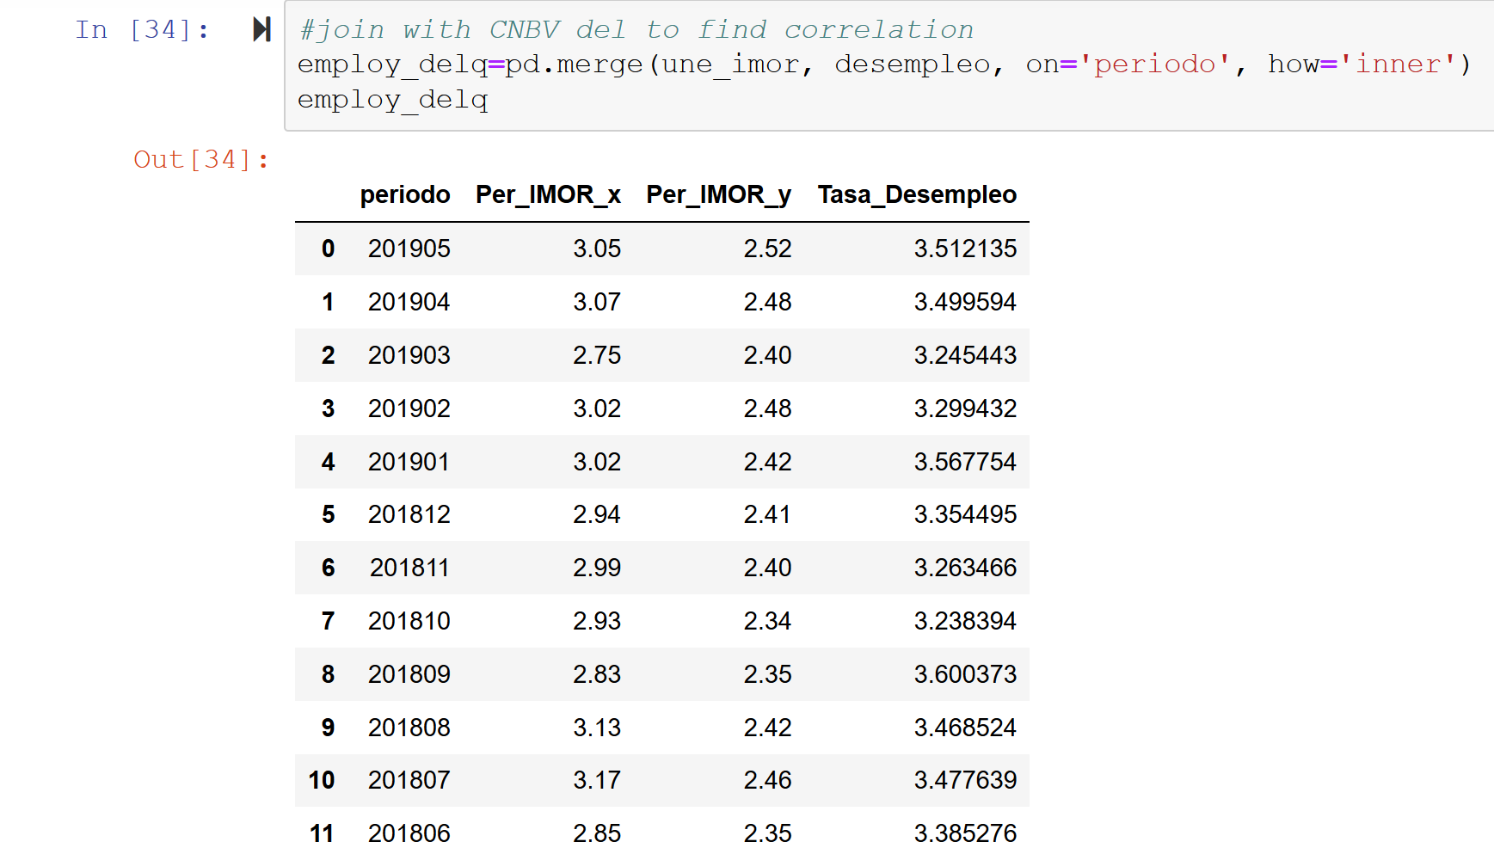
THE DATA CLEANUP, EXPLORATION & ANALYSIS PROCESS
STEP 5: ALL DATA
Use Jupyter Notebook & Pandas to:
Consolidate and read all data sets
Merge CNVB data & INEGI national data TO CREATE SECOND AND THIRD DATA SET
Create DataFrames to isolate target data
Manipulate and explore target data (calculations, new data columns, etc) in a manner which facilitates the exploration of correlation between factors

Slide 20
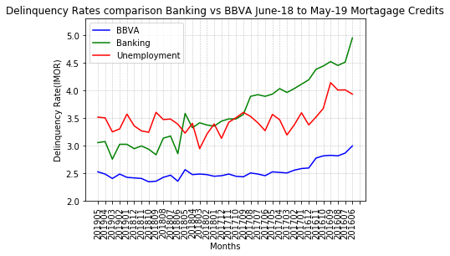
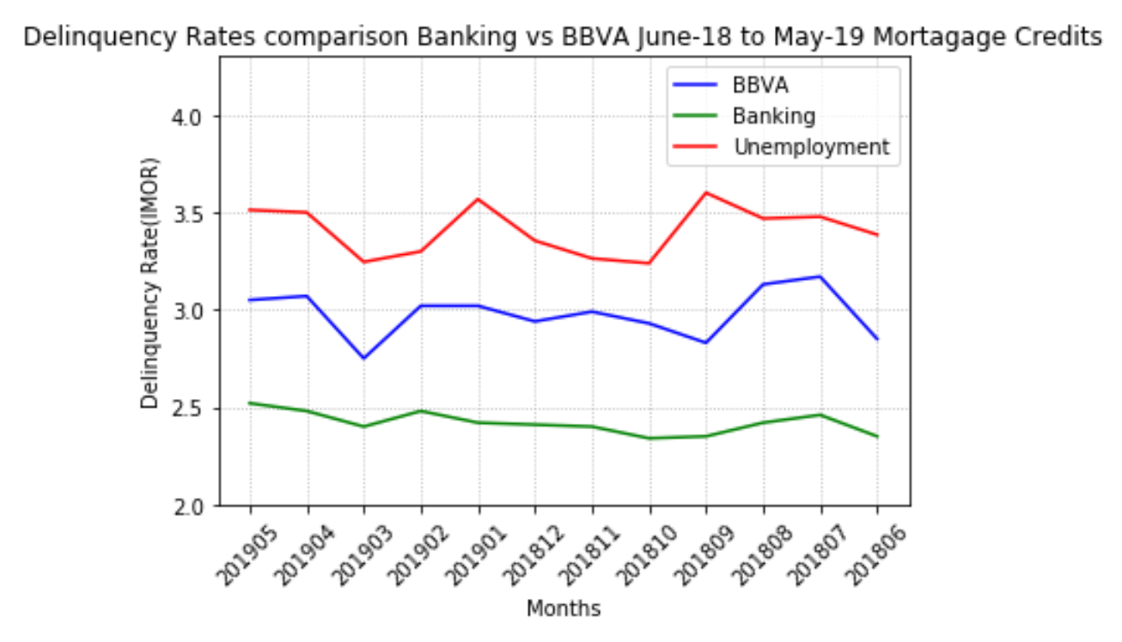
THE DATA CLEANUP, EXPLORATION & ANALYSIS PROCESS
STEP 5: ALL DATA
Use Jupyter Notebook, Pandas, MatPlotLib to:
Visualize manipulated data in a manner which facilitates the analysis of the existence of correlations between factors

Slide 21
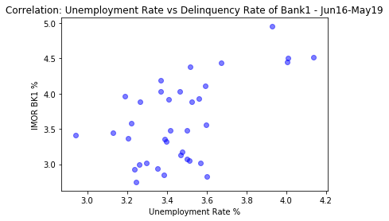
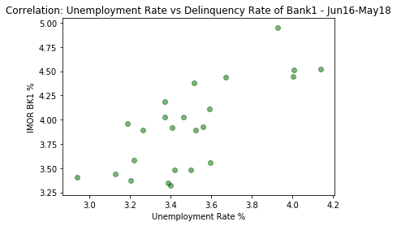
ANALYZING RESULTS - Bank1 vs. Unemployment
STEP 5: Analyze Results and make conclusions
corr= 57.4% Jun’16 to May’19
corr= 74.2% Jun’16 to May’18
(without election factor)
TTest=pvalue=0.1812703924720549
H0 can not be rejected
TTest=pvalue=0.0003639892349498939
H0 can be rejected
MannWhitney=pvalue=0.3221182654259463
H0 can not be rejected
MannWhitney=0.0010241434442777328
H0 can be rejected

Slide 22
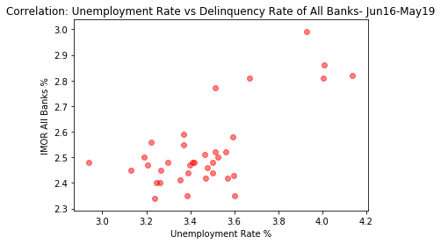
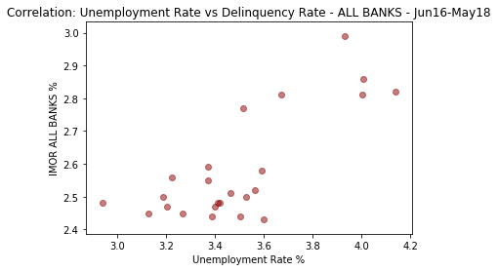
ANALYZING RESULTS - All Banks vs. Unemployment
STEP 5: Analyze Results and make conclusions
corr= 70.83% Jun’16 to May’19
corr= 77.05% Jun’16 to May’18
(without election factor)
TTest=pvalue=1.2646103738893473e-26
H0 can be rejected
TTest=pvalue=2.0737499259476036e-15
H0 can be rejected
MannWhitney=pvalue=1.6344830190455893e-13
H0 can be rejected
MannWhitney=1.7195511991664829e-09
H0 can be rejected

Slide 23
Conclusions of Analysis:
Data significance proven, very low p-values
Graphical test can be misleading, thus:
Strong positive correlation between selected variables (2nd round)
Other external factors can also impact delinquency trends (need to further analyze)
Our project can be useful to compare mortgage credit portfolios against the market and other public metrics to provide a model to predict what to expect in the future about portfolio performance and establish additional policies for insurance companies to consider during pricing.

Slide 24
Key Takeaways
Data Analysis Paradigm and “Clear” path on what needs to be done as a blueprint to be more effective
Being flexible to adjust “on the go” (not everything goes as expected)
Importance of data sources
Quality Data gathering, source, scope and extension, acknowledge limitations
Data processing importance
Results interpretation
Team work for faster and more powerful analysis!!

Slide 25
REFERENCES
https://www.genworth.com/
https://www.inegi.org.mx/servicios/api_indicadores.html#indicadorI
https://portafoliodeinformacion.cnbv.gob.mx/bm1/Paginas/infosituacion.aspx
https://www.britannica.com/science/statistics/Residual-analysis
Neither regression nor correlation analyses can be interpreted as establishing cause-and-effect relationships. They can indicate only how or to what extent variables are associated with each other. The correlation coefficient measures only the degree of linear association between two variables. Any conclusions about a cause-and-effect relationship must be based on the judgment of the analyst
https://www.ncbi.nlm.nih.gov/pmc/articles/PMC3576830/
 | Coefficient, r
Strength of Association | Positive | Negative
Small | .1 to .3 | -0.1 to -0.3
Medium | .3 to .5 | -0.3 to -0.5
Large | .5 to 1.0 | -0.5 to -1.0

